Slide 1
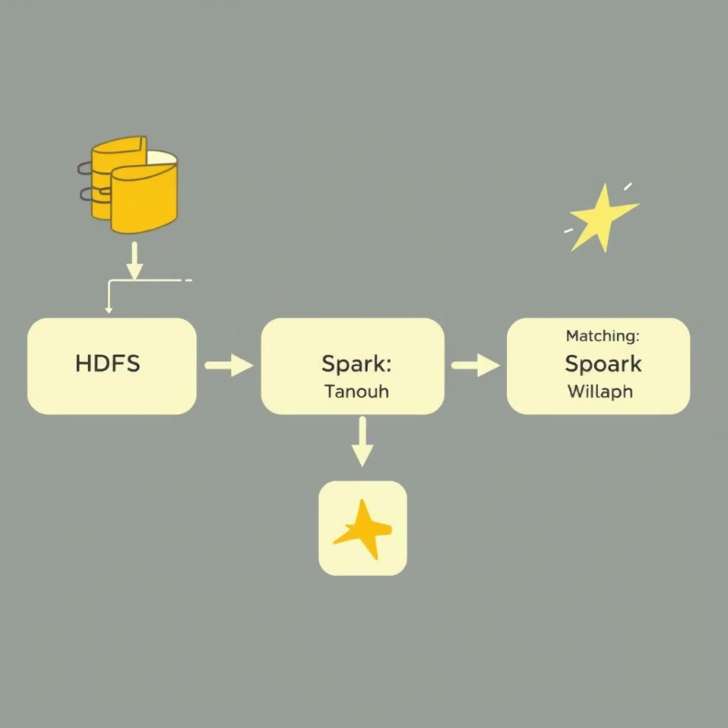
LinkedIn Jobs Classification with PySpark
Project Overview
Predict job type (Full-time, Part-time, Contract) from LinkedIn job postings.
Dataset
LinkedIn job postings (CSV in HDFS).
Input Data
job_title, company, job_location, job_level, job_type (target).
1
2
Tech Stack & Workflow
Key Outcome
Apache Spark, PySpark, Spark MLlib (Logistic Regression).
Accurate classification of job types to streamline recruitment and job search.
Data reading & cleaning, StringIndexer, VectorAssembler, model training, accuracy evaluation.

Slide 2
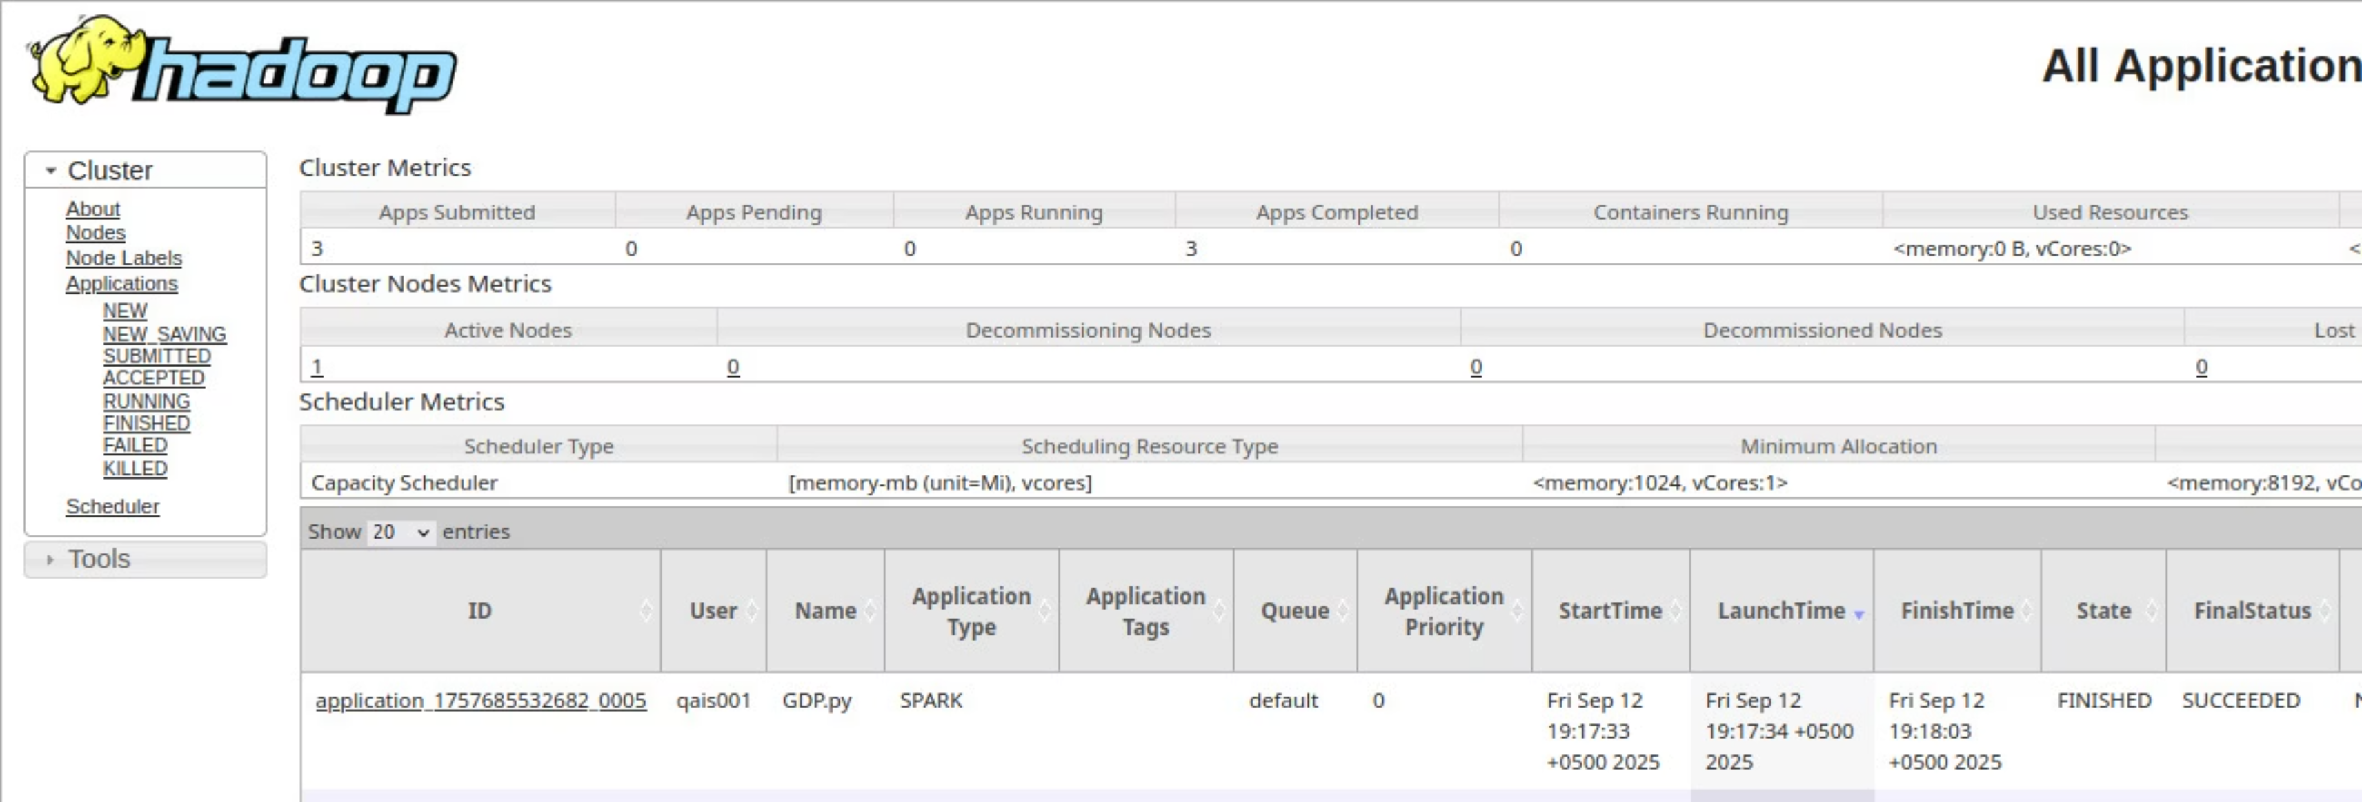
YARN
src.py

